Slide 1






GUIDINI
Presentation

Slide 2

PROBLEMATIC
The struggles of delay ,long procedures and the overwhelming amount of required documents in any governmental establishment.

Slide 3
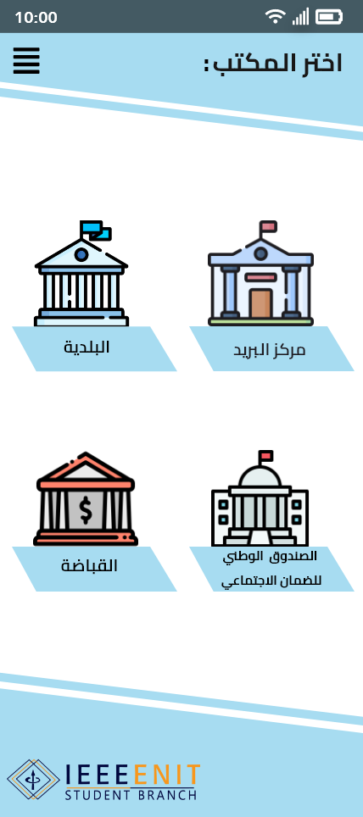


Our solution:
GUIDINI
To enhance the UX (user experience), we chose to work using Adobe XD. As shown here the app will start with the login page, where you're supposed to enter your ID card number and your city. Then, you'll need to choose the establishment in order to move on to the service of choice.

Slide 4
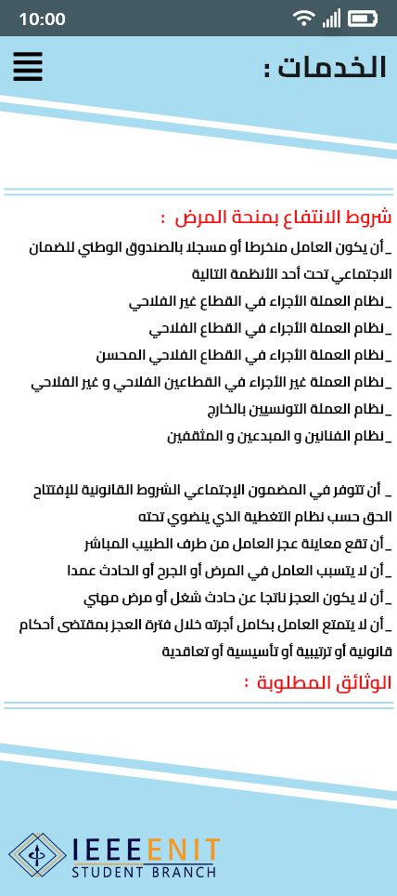
SERVICES
Here you will find the possible services provided by the chosen establishment and every needed documents for your demands.

Slide 5
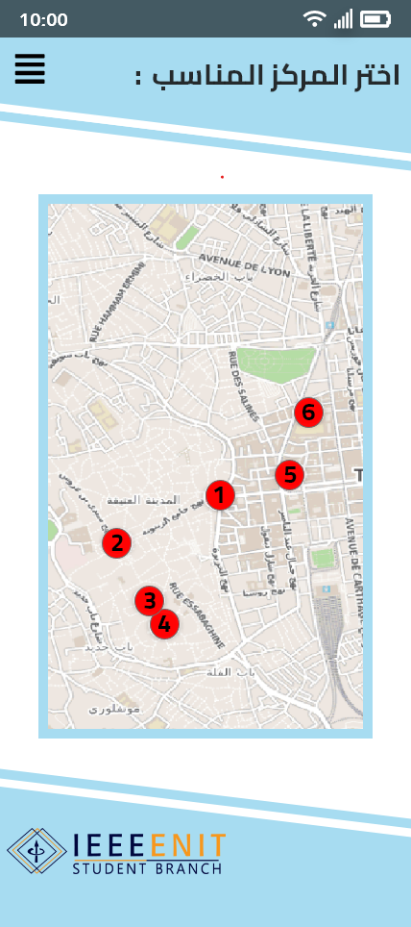
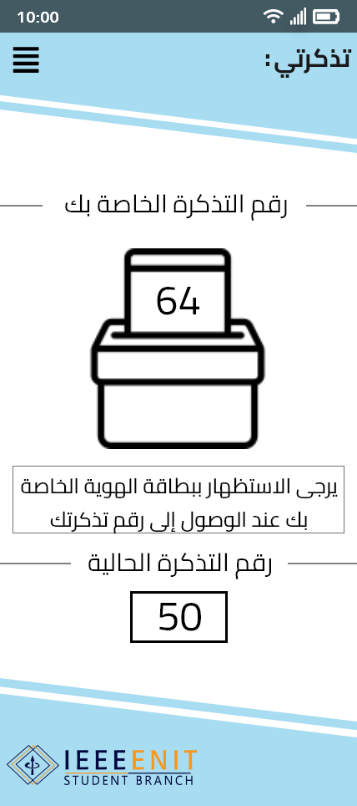
TICKETS
this service offers the ability to reserve a ticket online. You'll be shown a map containing the establishments located in the city you chose when logging in. After choosing the app showcases both the current and your own ticket numbers and when your turn is up you show up and display your ID card to the employee.

Slide 6
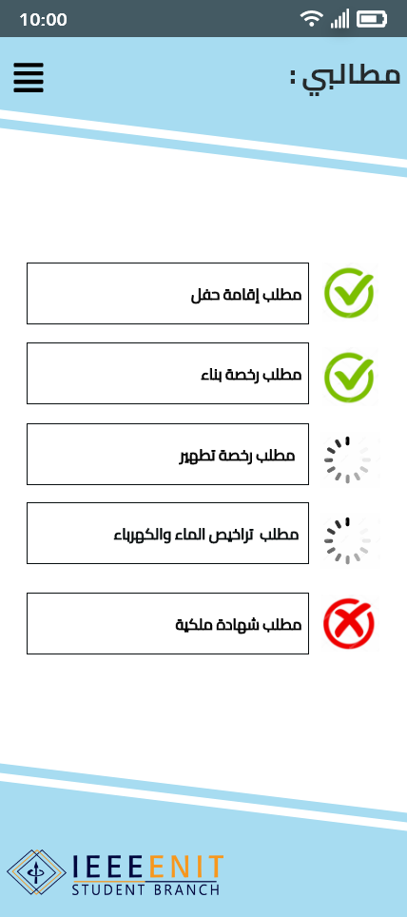



DEMANDS
This feature gives you the ability to keep track of your demands in each establishment and notifies you when one gets accepted or rejected. A demand has 3 possible states:
accepted
processing
rejected

Slide 7
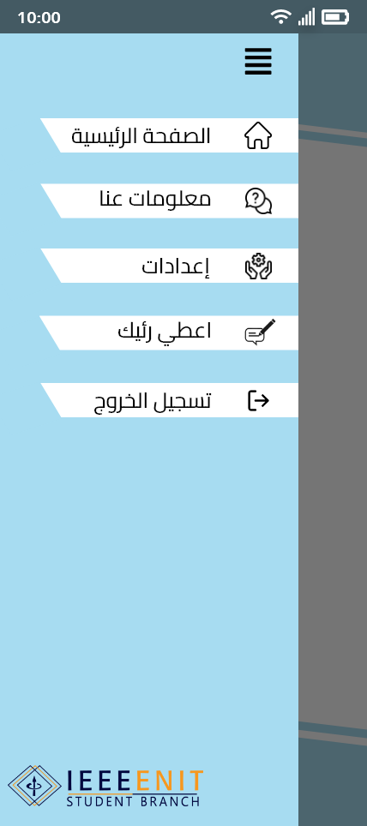
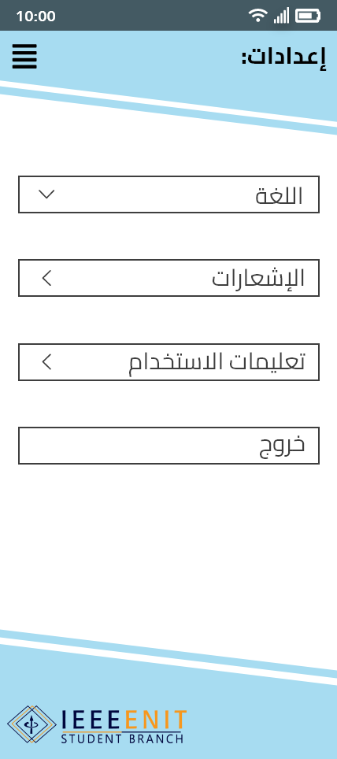
MENU
Our app has a menu that contains features essential to every app:
#1 HOME PAGE
This will take you to the home page where you choose the establishment
#2 SIGN OUT
This will log you out and take you to the login page
#3 SETTINGS
This will allow you to modify the language and notifications and to learn how to use the app

Slide 8

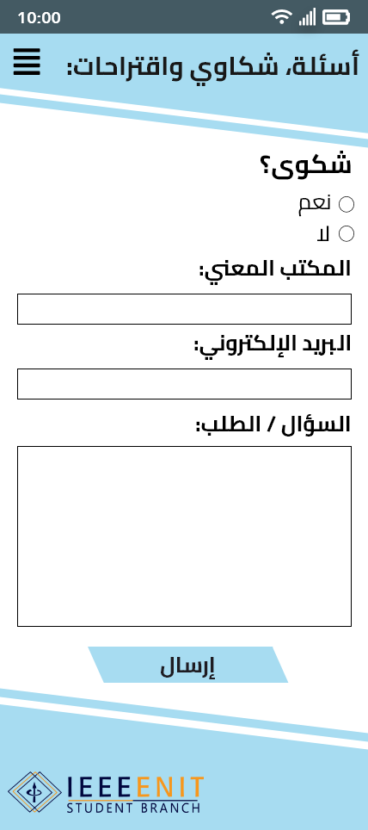
MENU
#4 ABOUT US
This page contains information about us, the app creators and some of our social media links
#5 FEEDBACK
This allows you to send us your complains, remarks or questions privately because your opinions matter to us and we are looking to expand upon and improve this app in the future.

Slide 9


REALISABILITY
While in the process of making the app, we tried to keep our idea realistic and achievable. We also faced the online signature problem since it's far from being possible to implement in Tunisia. So the presence of the citizen is still necessary. That's why we focused our efforts into making that presence as short and smooth as possible.

Slide 10


THANK YOU
FOR YOUR ATTENTION

